Slide 2

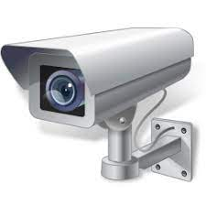
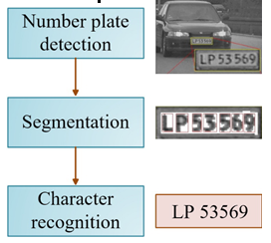














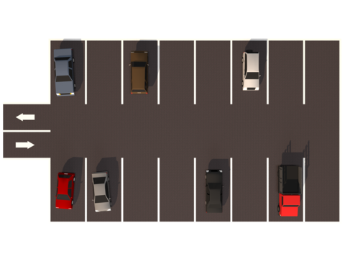

OBJECT DETECTION
Image Processing
Processing Server
Parking Database for Permanent Data Storage
Store Data
Request Processing
Parking Entrance Camera
Real Time Object Images
Plate Number
Plate Number Image Send to Server
Store Data
Local Storage for Already Verified Cars to Reduce Request Time
Plate Number Verification with 3rd party API
Image Extraction
Valid Car and Owner Details
All Data Collected by Agent from Local Storage
Third Party API
MONITORING
PARKING SLOT ALLOCATION
Slot Selection Timer
Request Slot
Car Details
Real Time Slot Images
Owner Details
Parking Slot Camera
User Requested Slot If Selected within Time otherwise Nearest Slot will be Allocated to User
Real Time Slot Images
Goal Based Agent
Real Time Slot Images
Duration Details
Fee Details
Notification Alerts
Real Time Empty/Occupied Slots on User Mobile App using Deep Learning
Model Training using Deep Learning

Slide 3
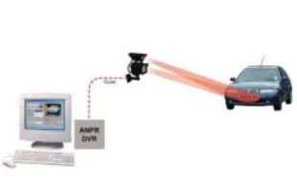

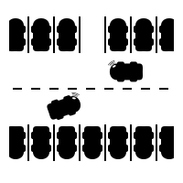



Image Extraction
Real Time Slot Images
OBJECT DETECTION
MONITORING
SLOT ALLOCATION
Image Processing
Parking Fee Details
Localization
Vehicle & Owner Info
Parking Duration Details
Real Time Slots
Edge Detection
Direction to Parking Slot
Driver Details
Character Segmentation
Request Slot
User
Vehicle Details
Plate Number
Plate Number
Display on User Mobile App
Send Alerts
3rd Party API
Goal Based Agent
Process Slot Images
Deep Learning
Vehicle & Owner Details
Free/Occupied Slots

Slide 4

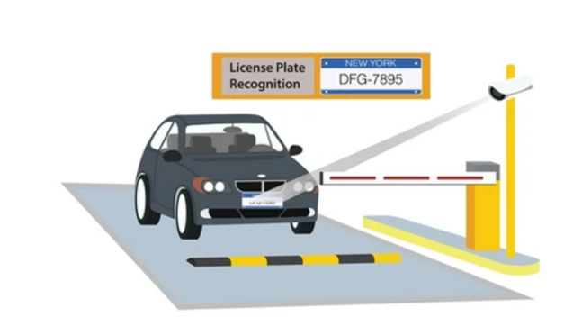



User
Object Detection
Image Processing
Server
Vehicle and Parking Slot Details
Free/Occupied Slot
Monitoring Agent
Vehicle Details
Parking Slots Info
Parking Slot Allocation

Slide 5
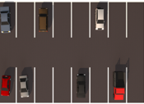
PARKING SLOT ALLOCATION
Real Time Slot Images
Model Training using Deep Learning

Slide 6

Local Storage
Real Time Slot Images
Data Preprocessing
Data Split
Processing
Train and Test
Split
Split
Free/Occupied Slots
Training
Testing
Output
Training Data
Testing Data
Trained Model
Accuracy Precision Recall F1-Score
Free/Occupied Slots
Evaluation
Deep Learning Models

